Slide 1
Predicting the response of the oceanic carbon cycle to climate change
Eco-evolutionary modeling of the microbial loop and the role of viruses
Philippe Cherabier, Institut de Biologie de l’Ecole Normale Supérieure (IBENS)
Sous la direction de Régis Ferrière, professeur à l’Institut de Biologie de l’Ecole Normale Supérieure (IBENS)
Notes:
Thank you everyone for attending and giving me the opportunity

Slide 2
Notes:
Earth is often called « The Blue Planet »
Oceans span over 70% of the surface
Human health, economy & culture rely, but also global climate
Physical+chemical processes determine atm CO2 over millenia
Shorter timescales: absorb 1/3 man-made emissions
In this thesis, we focus on the biological mechanisms that trap carbon, the biological carbon pump
The biogeochemical cycles are driven by « microbial engines »
50% pp comes from phytoplankton

Slide 3
CO₂
The biological carbon pump
DIC
Free-living
bacteria
Climate change threatens the microbial loop and may alter its function.
Phytoplankton
pH
Zooplankton
DOM
Biological feedbacks to these environmental changes induce different degrees of uncertainty to large-scale predictions.
Higher trophic
levels
Attached
bacteria
POM
Notes:
Follow the path of carbon in the ecosystem
Remineralization through respiration
Explain the viral shunt
Large scale predictions often miss a crucial component of microbial feedback
They often assume identical populations in 100 years
The population response is thought to be the sum of individual plastic responses
In reality, bacterial populations evolve due to natural selection, and they do it fast

Slide 4
[Antibiotics]
None
1
10
100
10
1
None
Bacterial colonies
Baym, Michael, et al. "Spatiotemporal microbial evolution on antibiotic landscapes." Science 353.6304 (2016): 1147-1151.
Notes:
Video on the screen
Large petri dish where growth medium is in black and bacterial colonies in white
A selection of bacterial colonies start at the arrows
The medium become more and more hostile as they approach the center
Increasing concentrations of antibiotics
As they approach a new environment, new, increasingly resistant populations appear
Striking example of adaptation of antibiotics resistance, but why is this important for climate change?

Slide 5
How will the microbial loop respond to bacterial adaptation under climate change, and what consequences for biogeochemical cycles?
?
Notes:
Heterotrophic bacteria adaptation will influence the recycling pathway, which will jump start an eco-evolutionary feedback loop

Slide 6
Outline
Microbial loop
modeling
Sea-surface
response
Earth-system
models
Viral shunt
influence
Viral
transduction
Notes:
Transduction focuses more on bacterial adaptation processes

Slide 7
How do ecology and evolution interact to shape the microbial loop response to environmental change?
Microbial loop
modeling
Sea-surface
response
Earth-system
models

Slide 8
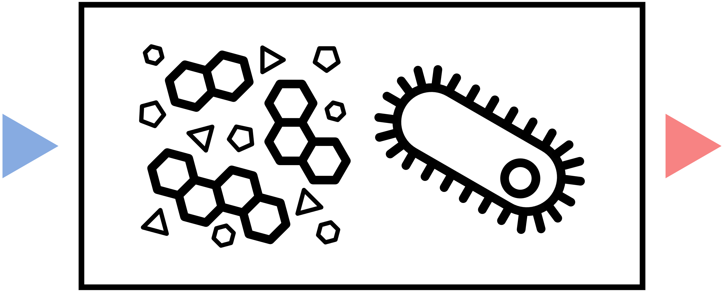
The microbial loop module
We aim for a simple and adaptable model
To fit both sea-surface theoretical models and Earth system models
Next step: defining temporal dynamics and evolutionary framework
Inputs
Outputs
Notes:
Have consistency throughout the thesis

Slide 9
Defining temporal dynamics
$$Waste$$
$$Respiration$$
Ecological dynamics of the system are determined by differential equations:
B
$$Production=Uptake −Respiration$$
$$=BGE ×Uptake$$
$$\frac{\text{d}B}{\text{d}t} =BP−Waste$$
$$Uptake$$
$$\frac{\text{d}DOM}{\text{d}t}=Input−Uptake$$
DOM
BGE = Bacterial growth efficiency
$$Input$$

Slide 10
Bacterial production
Respiration
Evolutionary framework
BGE can be seen as an evolutionary strategy regarding resource allocation.
Bacterial production
=
BGE
Uptake
Resource acquisition strategy
Yield strategy
0
BGE
1
There is a trade-off between bacterial growth efficiency (‘yield’) and uptake (‘resource acquisition’).
Uptake
BGE
$$U$$
Notes:
We need to focus on a specific phenotypic characteristic, a trait – which one?
Width of the column = amount of resource consumed
Why not invest everything in growth?
Respiration is the process that creates energy, and is crucial to have capacity to consume resource
No respiration = no uptake

Slide 11
Towards an evolutionary equilibrium
Hyopthesis of timescale separation:
New strains appear one at a time
Populations have time to reach their ecological equilibrium before a new strain appears
Elimination
Coexistence
Fixation
0
1
BGE
Evolutionary stable strategy
Notes:
Theoretical framework that allows to derive an evolutionary equilibrium
Monomorphic populations at ecological equilibrium
No cycles for instance
From the outcome of one invasion event, we can determine the ESS
But how do we determine this outcome?

Slide 12
BGE
ESS
Invasion fitness and selection gradient
0
1
A_{p}
Y_{p}
The invasion fitness measures the ability of a mutant population to replace the resident phenotype:
Competitive advantages
Initial individual growth rate of the mutant in a resident population at equilibrium
$$S\left(\text{BGE}\text{′},\text{BGE}\right)=\left(\frac{\text{BGE}\text{′}}{\text{BGE}}−1\right)×bp(\text{BGE})$$
Of yield
→ Increasing in BGE’
S(BGE’,BGE) =
$$+ \text{BGE}\text{′}×(u\left(\text{BGE}\text{′}\right)−u\left(\text{BGE}\right))$$
Of resource acquisition
→ Decreasing in BGE’
$$Elimination$$
0
$$Fixation$$
Both competitive advantages have opposite signs.
Considering infinitesimal mutations, we can define the selection gradient to measure the strength and direction of evolution for any BGE:
ESS BGE* such as
dS(BGE*) = 0
dS(BGE) = Y_{p} + A_{p}
dS(BGE) = ∂₁S(BGE’,BGE)|_{BGE’=BGE}
Notes:
There is a measure called the invasion fitness

Slide 13
Eco-evolutionary response
We compare three scenarios to determine the eco-evolutionary response of the ecosystem to environmental change.
1.
Initial adaptation
Ecosystem state in absence of bacterial adaptation
Ecosystem state in presence of bacterial adaptation
Ecosystem function (e.g. primary production)
3.
BGE’
2-1
3-2
3-1
+
=
2.
BGE
Ecophysiological response
Effect of bacterial adaptation
Eco-evolutionary response
Environmental variable (e.g. temperature)
Notes:
Presentation of an analysis scheme that allows to derive the components of the eco-evolutionary responses

Slide 14
How does bacterial adaptation shape local primary production in sea-surface ecosystems and its response to warming?
Microbial loop
modeling
Sea-surface
response
Earth-system
models

Slide 15
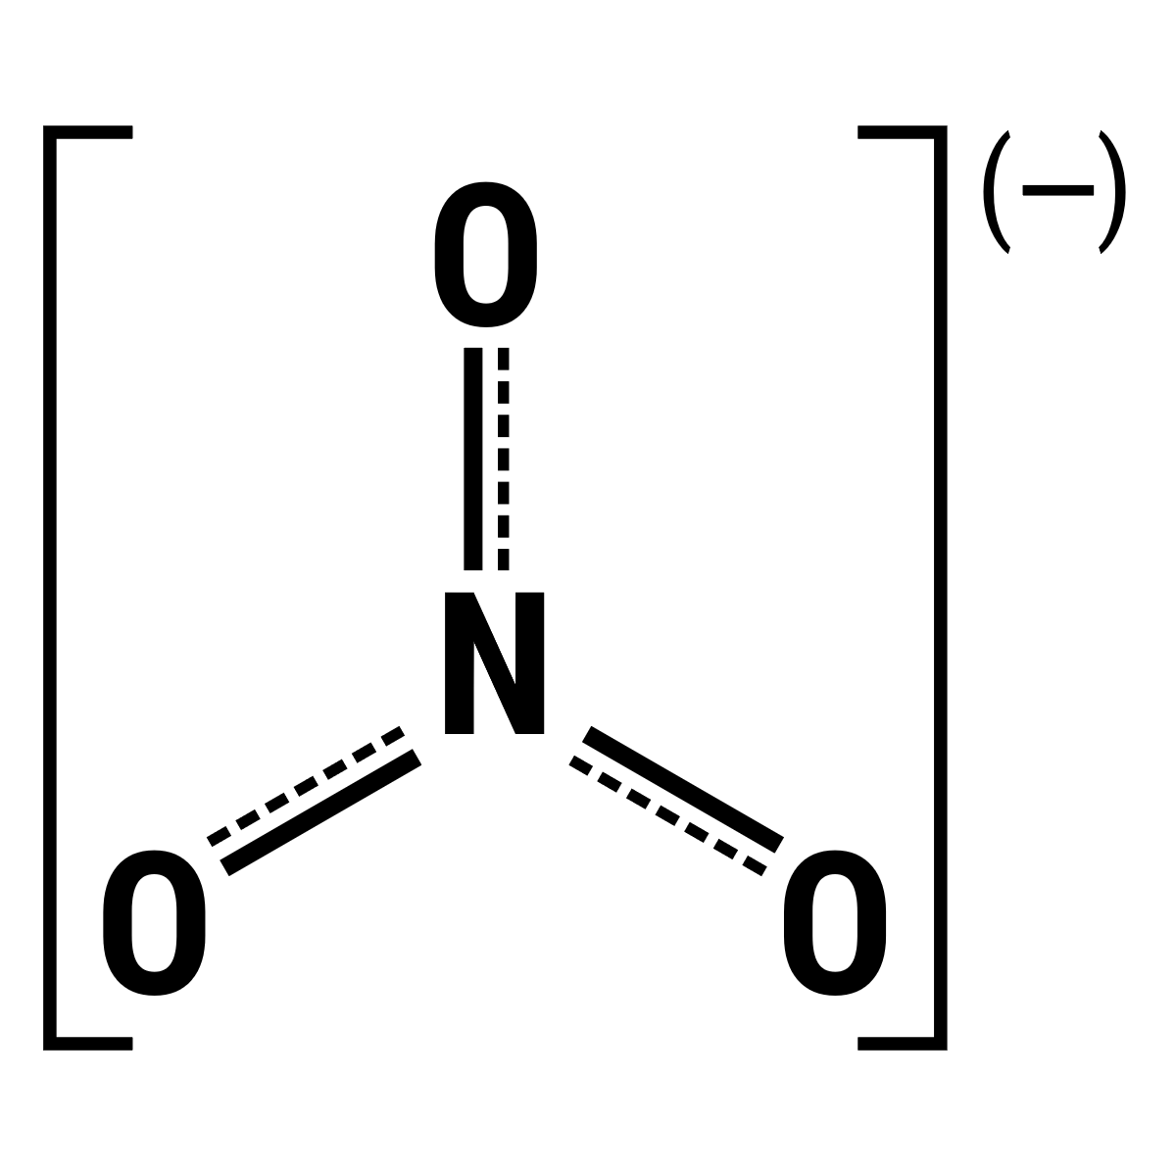
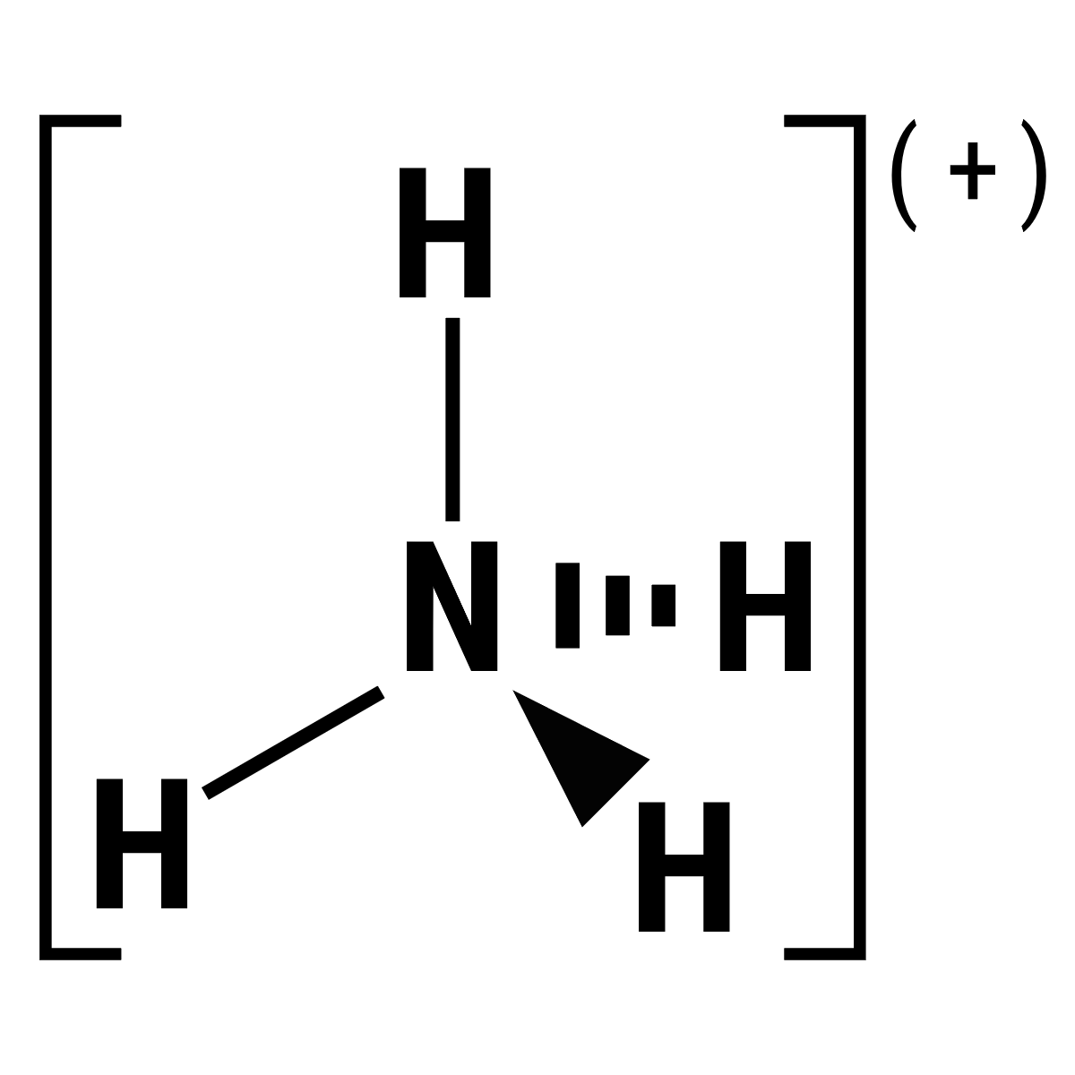
Higher
trophic levels
A sea-surface ecosystem
Grazing
Grazing
Surface water temperature:
+5°C
T₀
T₁
Respiration
Total nitrogen concentration in the ecosystem:
New
production
Regenerated
production
Uptake
0.05 mmol / m³
Waste
production
( - )
4.55 mmol / m³
3.75 mmol / m³
Upwelling
Notes:
Name each compartment
Say that we draw a set of random parameters 1.000 times

Slide 16
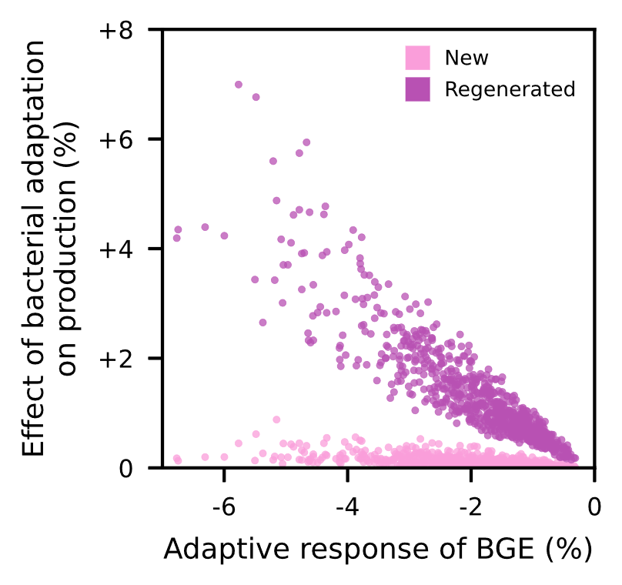
Primary production variations
A_{p}
Despite the global decrease in nitrogen concentration, primary production can either increase or decrease in absence of bacterial adaptation.
BGE
Primary production variations
0%
Ecophysiological response
+
Effect of bacterial adaptation
=
Eco-evolutionary response
( - )
The effect of bacterial adaptation shifts the response of primary production to a temperature increase.

Slide 17
Distribution at T0
Response to a temperature increase
Biogeographical responses
4 distinct regions are defined with respect to their initial temperature (cold vs. warm) and nutrient input (rich vs. poor).
Ecophysiological response
Effect of bacterial adaptation
Eco-evolutionary response
Bacterial adaptation can reverse predictions of productivity decrease in cold and poor regions.
Notes:
Beaucoup d’infos d’un coup, faire apparaître les axes

Slide 18
How does bacterial adaptation shape global primary production and its response to warming?
Microbial loop
modeling
Sea-surface
response
Earth-system
models

Slide 19
Classical form of the canonical equation is too precise and relies on strong assumptions
Integrating natural selection in ESMs
For each grid cell, the evolutionary dynamics are described by
$$\frac{d\text{BGE}}{dt}=α⋅B⋅P(\text{BGE})$$
It is an active research question with multiple leads. We propose a novel method based on the canonical equation of adaptive dynamics.
Adaptive capacity
Population size
$$\frac{dx}{dt}=μ\left(x\right)⋅\frac{σ^{2}\left(x\right)}{2}⋅N\left(x\right)⋅dS(x)⋅$$
Selection gradient
How can we define it in the context of Earth system models?
$$=$$
$$P\left(\text{BGE},E\right)$$
$$≈$$
$$dS(\text{BGE})$$
Not a mechanistic description
Mutation probability
Mutation variance
Population size
S = instantaneous invasion fitness
With this approach, populations stay monomorphic. This keeps the basic compartment structure of ESMs.
A_{p}
Y_{p}
0
1
BGE
Notes:
One further assumption about mixing water cells
New trait = weighted average of mixing traits
Alpha must be tuned to observe adaptation to new conditions in a few months, or a couple of years

Slide 20
Pros
Cons
$
Cost-effective
No phenotypic diversity
Computation at local scale
Long time scales
ESM compatible
No link to ‘omics

Slide 21
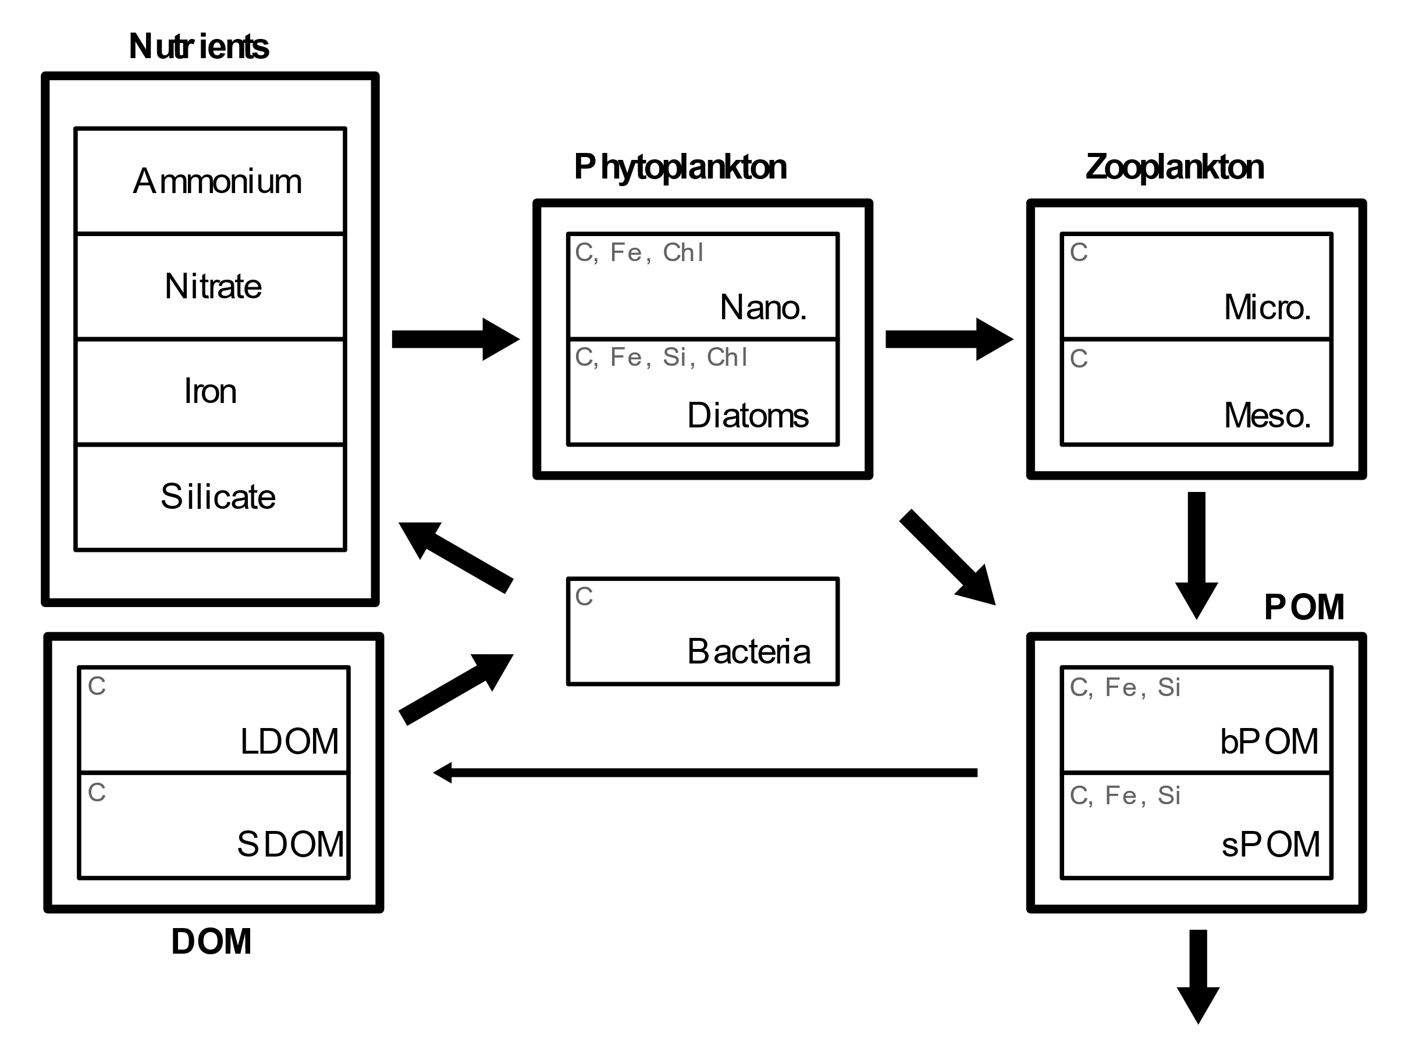
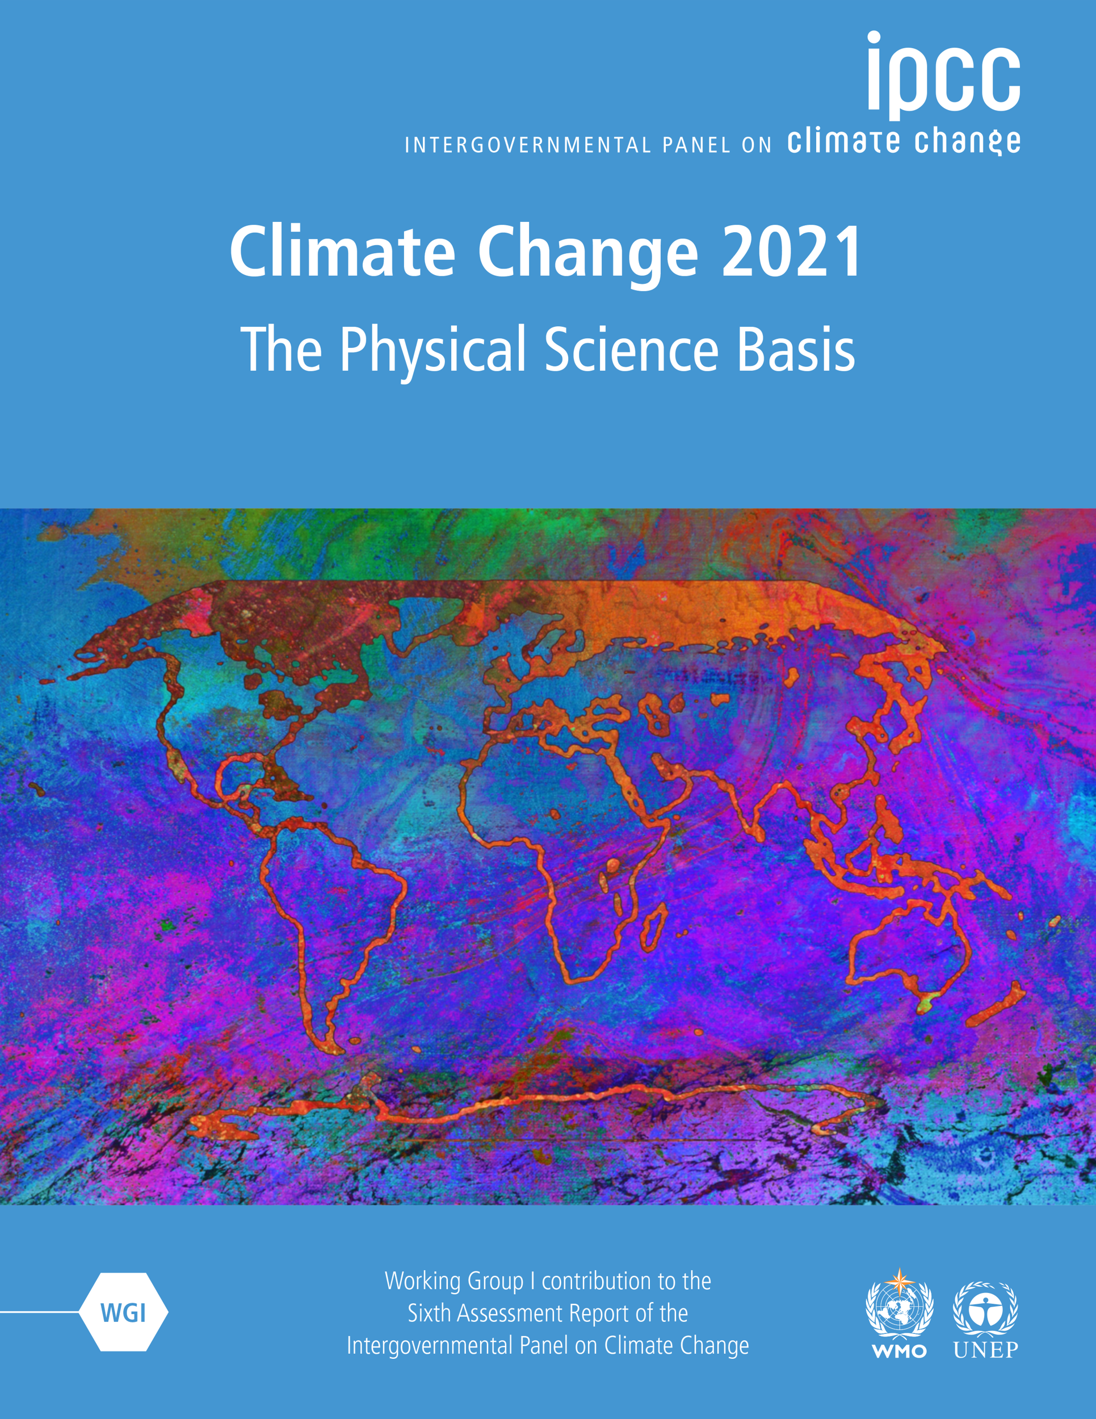
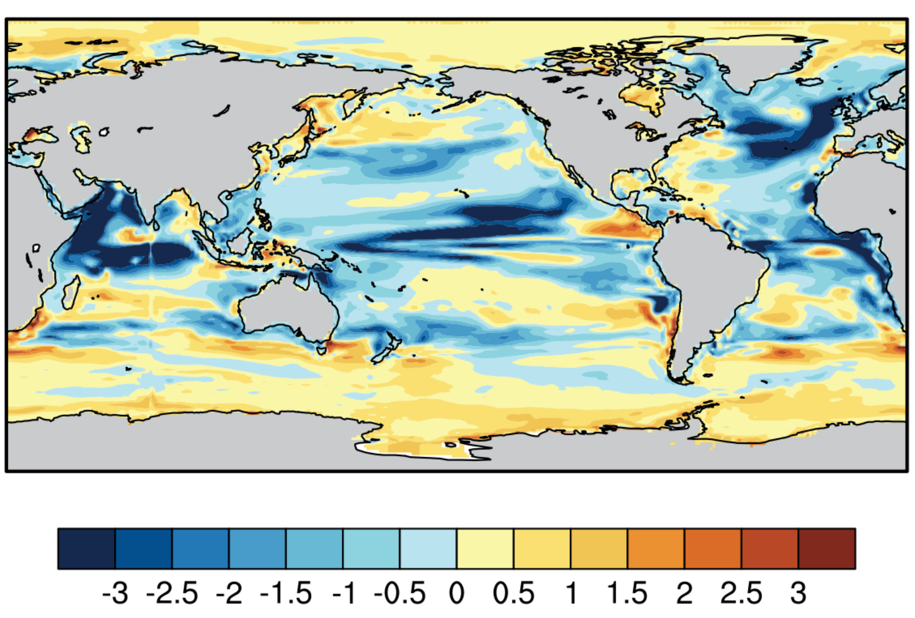
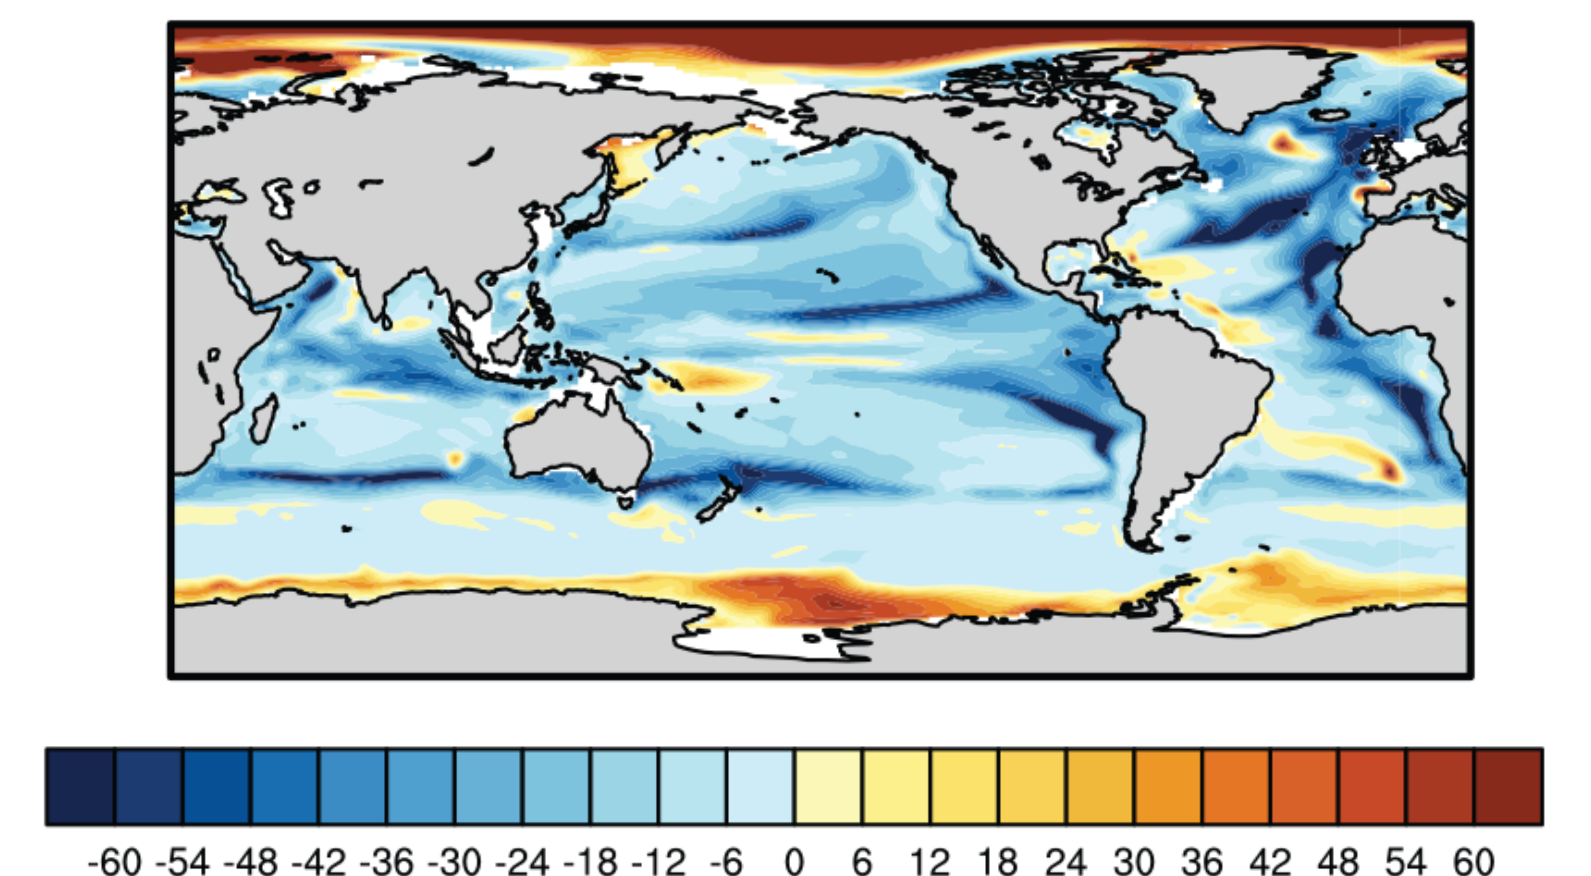
The NEMO-PISCES biogeochemical model
The NEMO-PISCES model is comprised of a physical (NEMO) and a biogeochemical (PISCES) component.
26 compartments
Used in CMIP6, and part of IPCC report, chapter 5
CMIP6
PISCES
Primary production anomaly (mol C/m²/year)
Export anomaly (mol C/m²/year)
Laufkötter et al. , 2015
Laufkötter et al. , 2016
Notes:
CMIP -- Coupled Model Intercomparison Project
In CMIP6, used in chapter 5 of « physical basis » of latest IPCC report
Anomalies
Between 2012-2031 and 2081-2100 RCP8

Slide 22
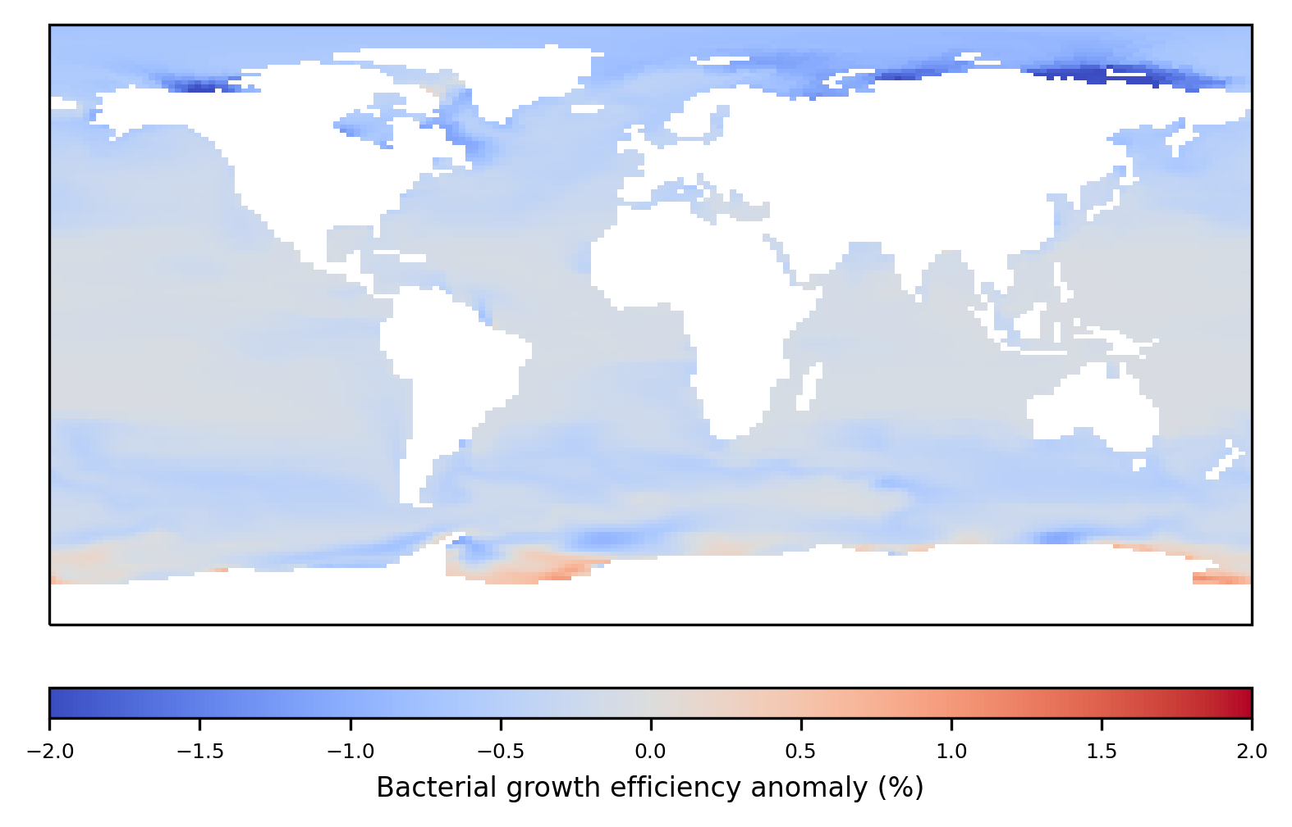
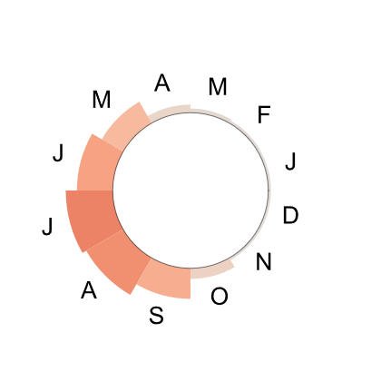
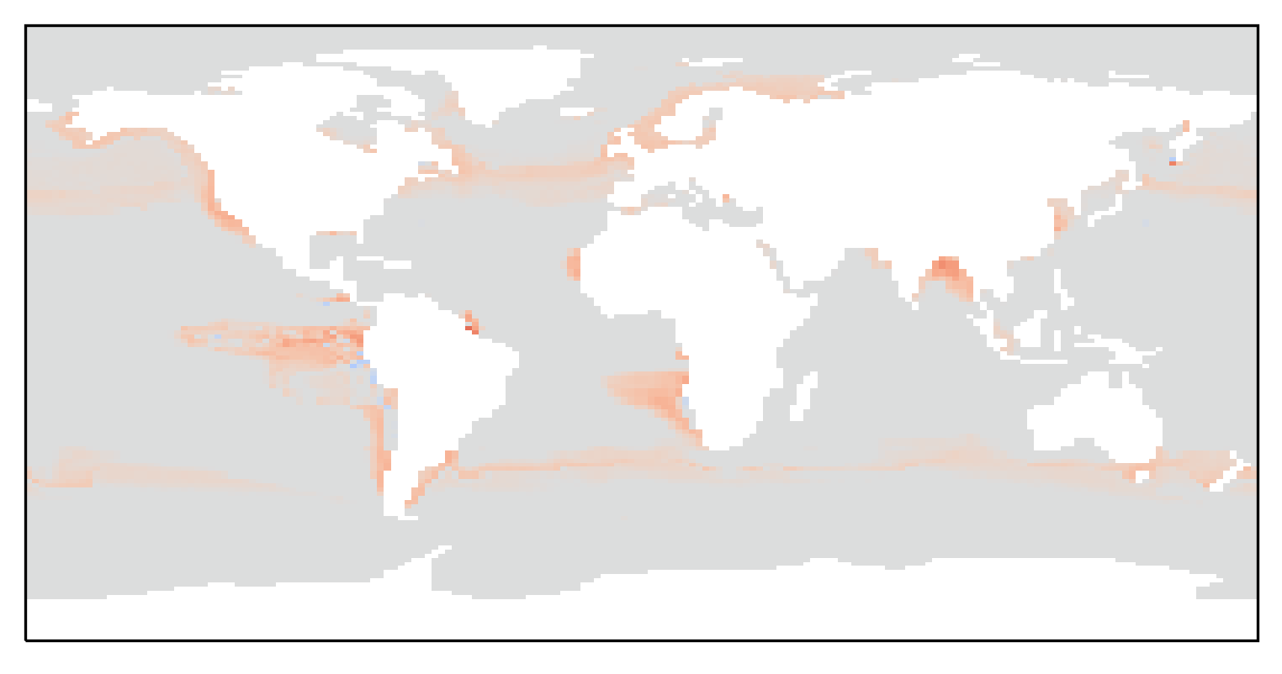
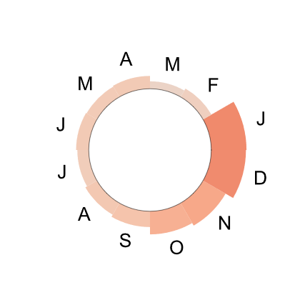
Primary production variation
Eco-evolutionary processes are integrated assuming LDOC limitation.
32
BGE (%)
27
22
+5°C
T₀
T₁
Notes:
No consideration of temperature, just BGE dependance
This is different from the thesis manuscript as we found a better way to represent ecophysiological response of the system

Slide 23
Eco-evolutionary increase in total primary production
13 million tons
Compounding effects of small variations
2.5%
Single environmental change (temperature)
1.3 billion tons
31 million tons
One evolving population (heterotrophic bacteria)

Slide 24
Conclusion
Microbial loop
modeling
Sea-surface
ecosystem
Earth-system
models
Viral shunt
influence
Transduction

Slide 25
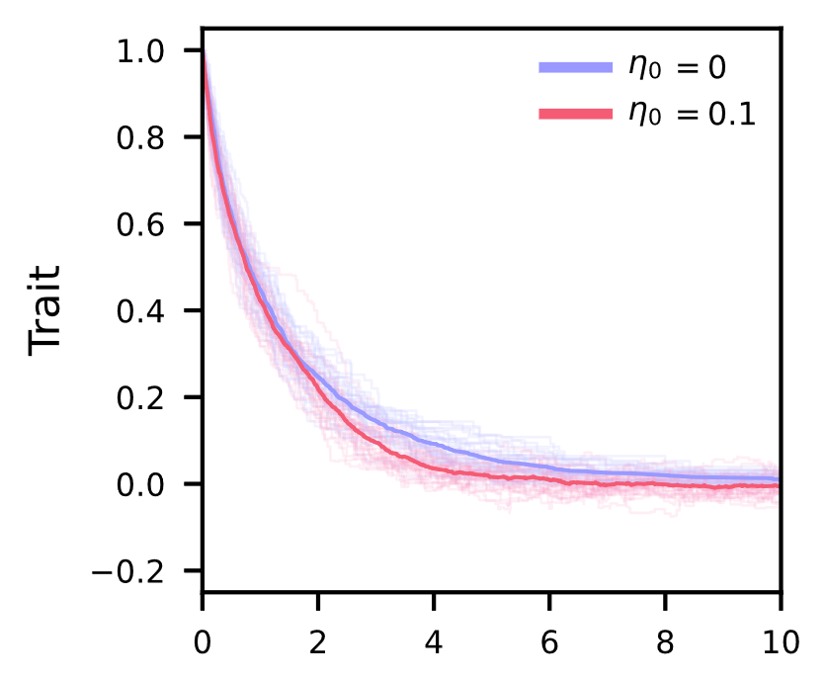
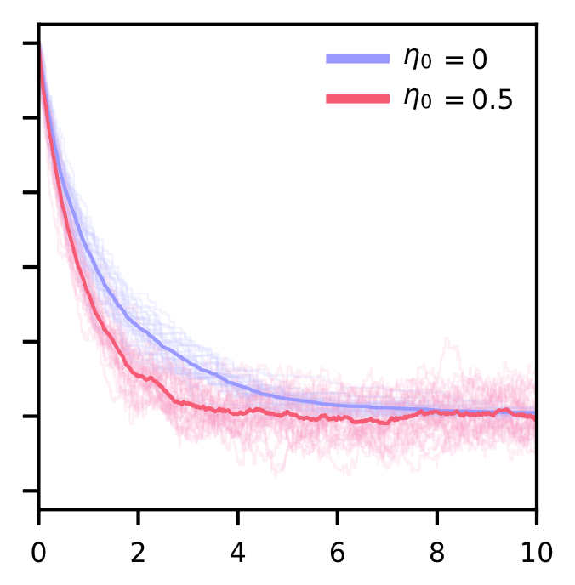
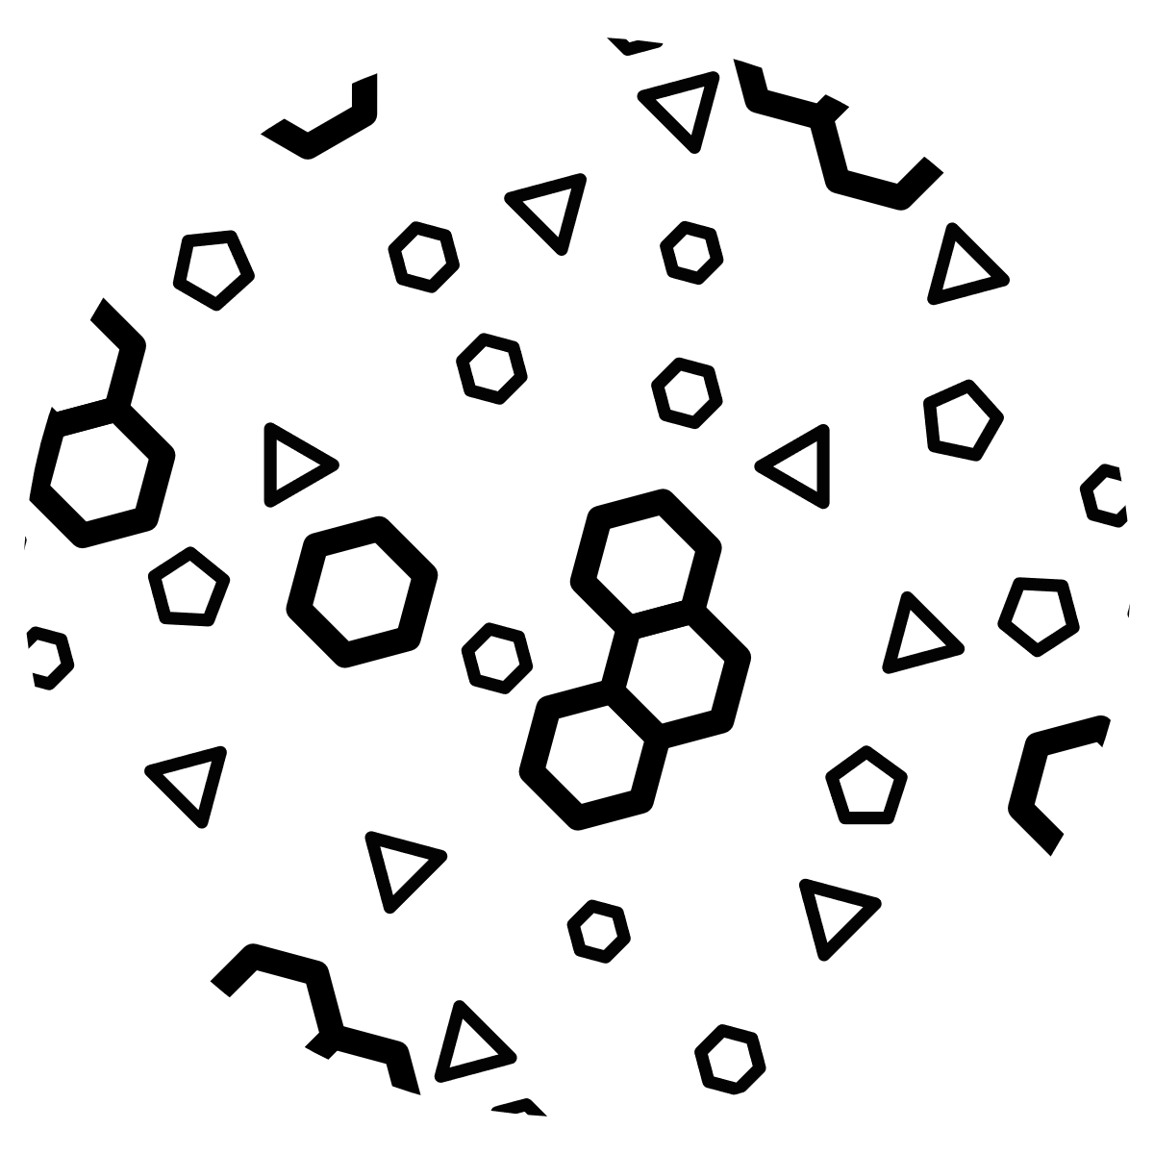
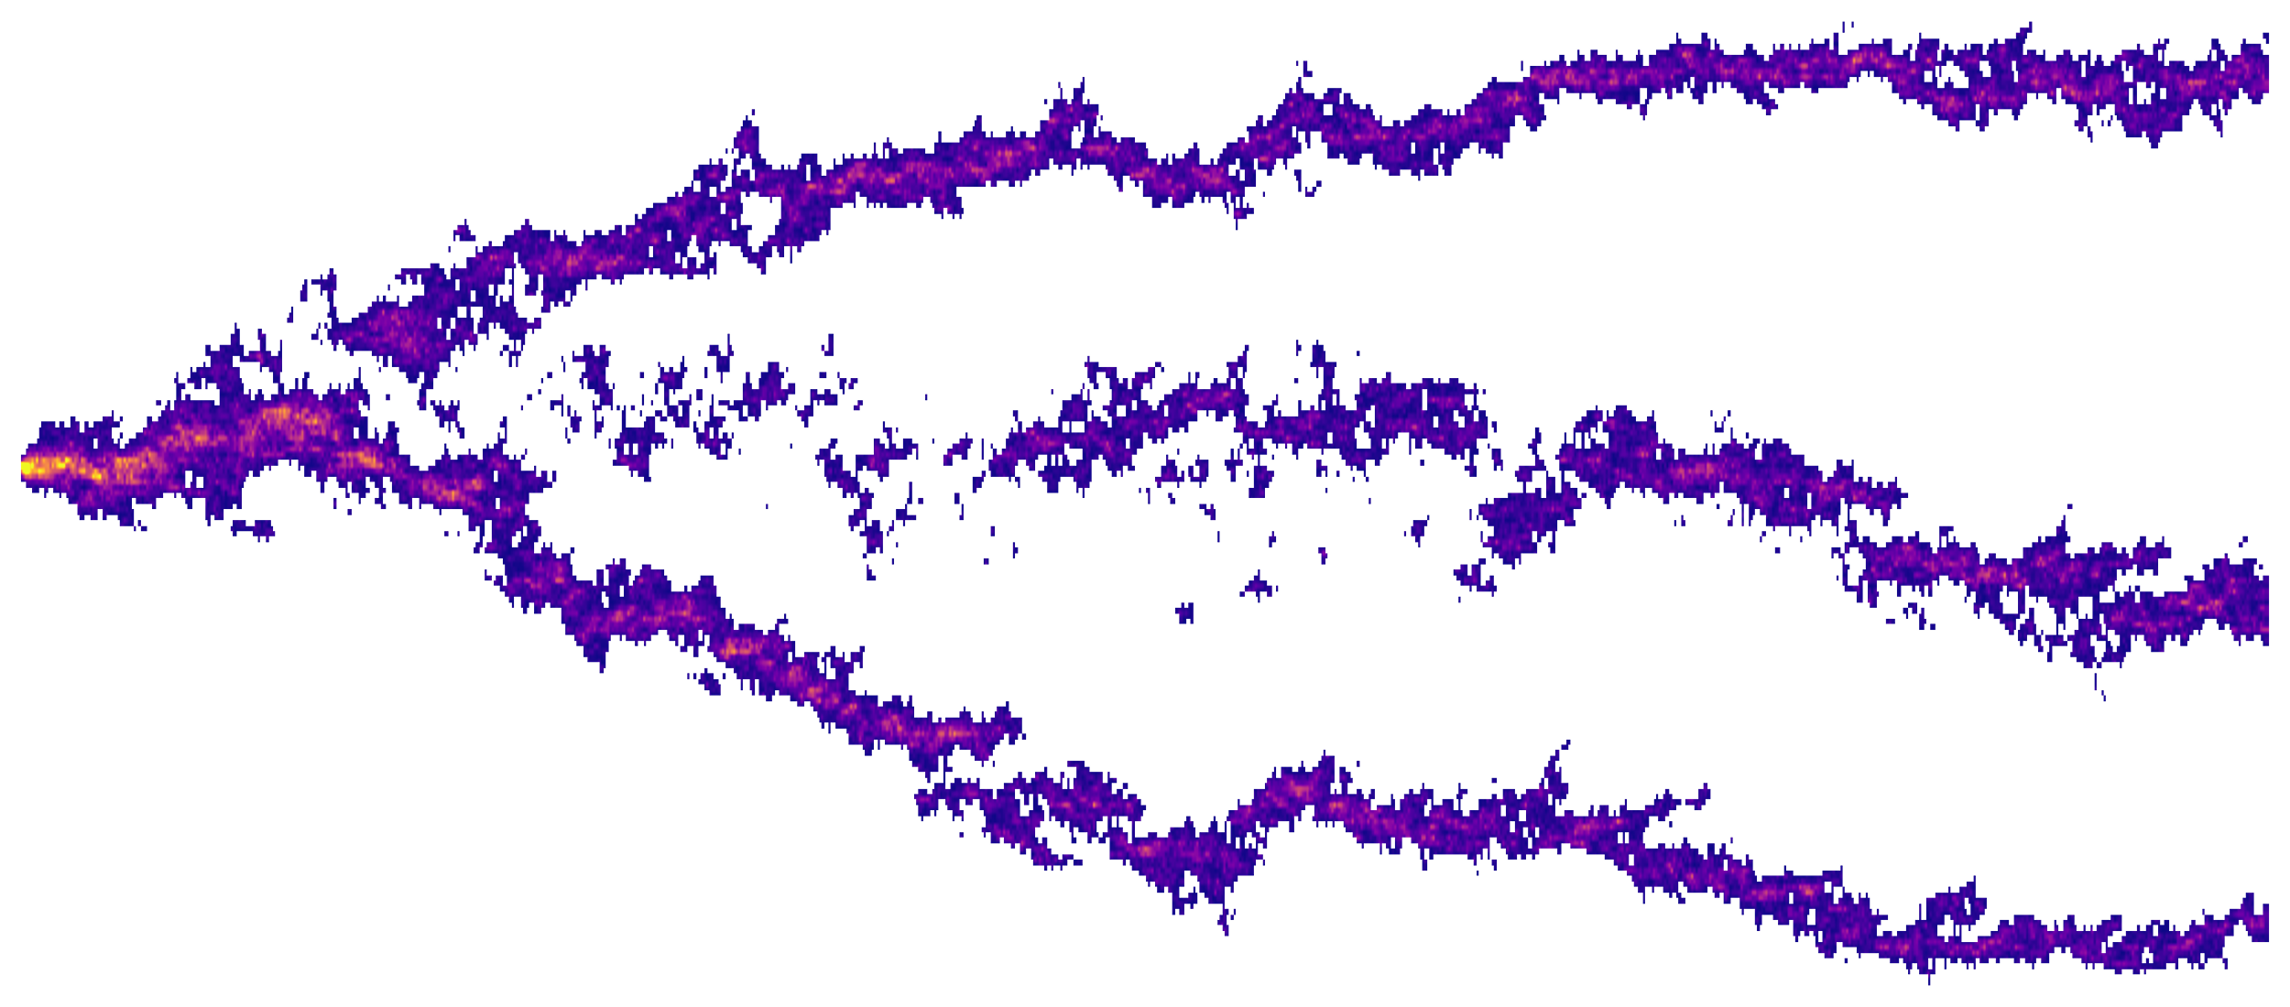
The next frontier: viral influence
ESS^{nb}
= maximum transduction probability
0
BGE
1
?
dS(ESS^{nb})
Time
Time
Trait
ESS
Oligotrophic regions
Eutrophic regions
Viral shunt
Transduction
- C -
Notes:
Viral shunt
Implication on PP? Some work already done, Weitz et al. 2015
Transduction
Mechanism allowing gene transfer and addition
Acceleration of adaptation + stochasticity: interesting outputs in ESM?
Phenotypic diversity: how to represent in ESMs?

Slide 26
Structure, results and perspectives
The goal of this thesis was to assess and quantify the role of heterotrophic bacteria in the response of the microbial loop to climate change.
RCP
- C -
Notes:
It highlights the importance of eco-evolutionary processes and shows that the evolutionary incertitude is comparable to the incertitude of ecological processes.
By studying the microbial loop, it focuses on a still poorly constrained system of current Earth system models. The interaction with bacteriophages

Slide 27
Thank you for your attention
Acknowledgements
Special thanks to everyone in the EEM lab and at the IBENS in general, to Sylvie Méléard, Olivier Aumont and Anh Pham for the joint projects, and to the BGC team in the ENS for the discussions.
Photographic credits
Earth: Wiki Images Pixabay
Galapagos: Copernicus Sentinel 2
Finches: John Gould, from Voyage of the Beagle
Tree of Life: Charles Darwin
Selective bibliography
Elsa Abs and Régis Ferrière. “Modeling Microbial Dynamics and Heterotrophic Soil Respiration: Effect of Climate Change”. In: Biogeochemical Cycles: Ecological Drivers and Environmental Impact. Ed. by Katerina Dontsova, Zsuzsanna Balogh-Brunstad, and Gaël Le Roux. American Geophysical Union, 2020. Chap. 5, pp. 103–131.
Jorge L Sarmiento and Nicolas Gruber. Ocean biogeochemical dynamics. Princeton University Press, 2006
Mya Breitbart, Chelsea Bonnain, Kema Malki, and Natalie A Sawaya. “Phage puppet masters of the marine microbial realm”. In: Nature microbiology 3.7 (2018), pp. 754–766.
Ben AWard, SineadCollins, StephanieDutkiewicz, SamanthaGibbs, Paul Bown, Andy Ridgwell, et al. “Considering the role of adaptive evolution in models of the ocean and climate system”. In: Journal of advances in modeling earth systems 11.11 (2019),
pp. 3343–3361.Farooq Azam, Tom Fenchel, J G_ Field, JS Gray, LAMeyer-Reil, and F Thingstad. “The ecological role of water-column microbes in the sea”. In: Marine ecology progress series (1983), pp. 257–263.
Notes:
Remerciements

Slide 28
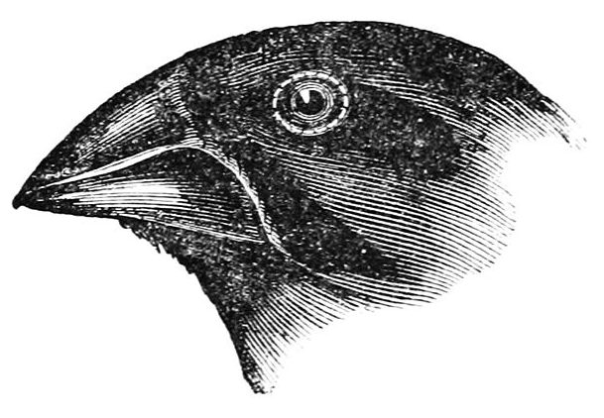
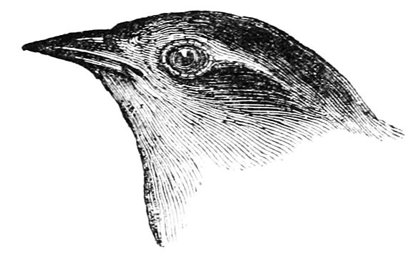
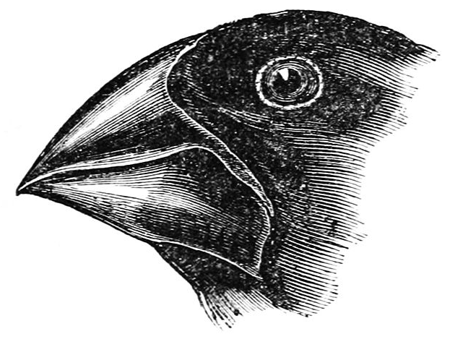
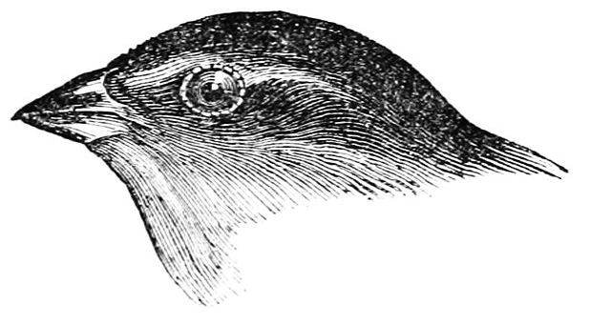
Darwin’s finches and natural selection
Proficiency in eating…
Seeds Insects
Notes:
To understand, we perform a though experiment with Darwin’s finches to see how natural selection operates and what consequences for the environment
Darwin’s finches
1830’s, Darwin observed a wide diversity of beaks in the Galapagos finches, all seemingly fit for the food source of their ecological niche
Eco-evolutionary feedback loop
By eating more nuts, large beeked finches can increase the spatial coverage of nut trees, influencing the environment

Slide 29
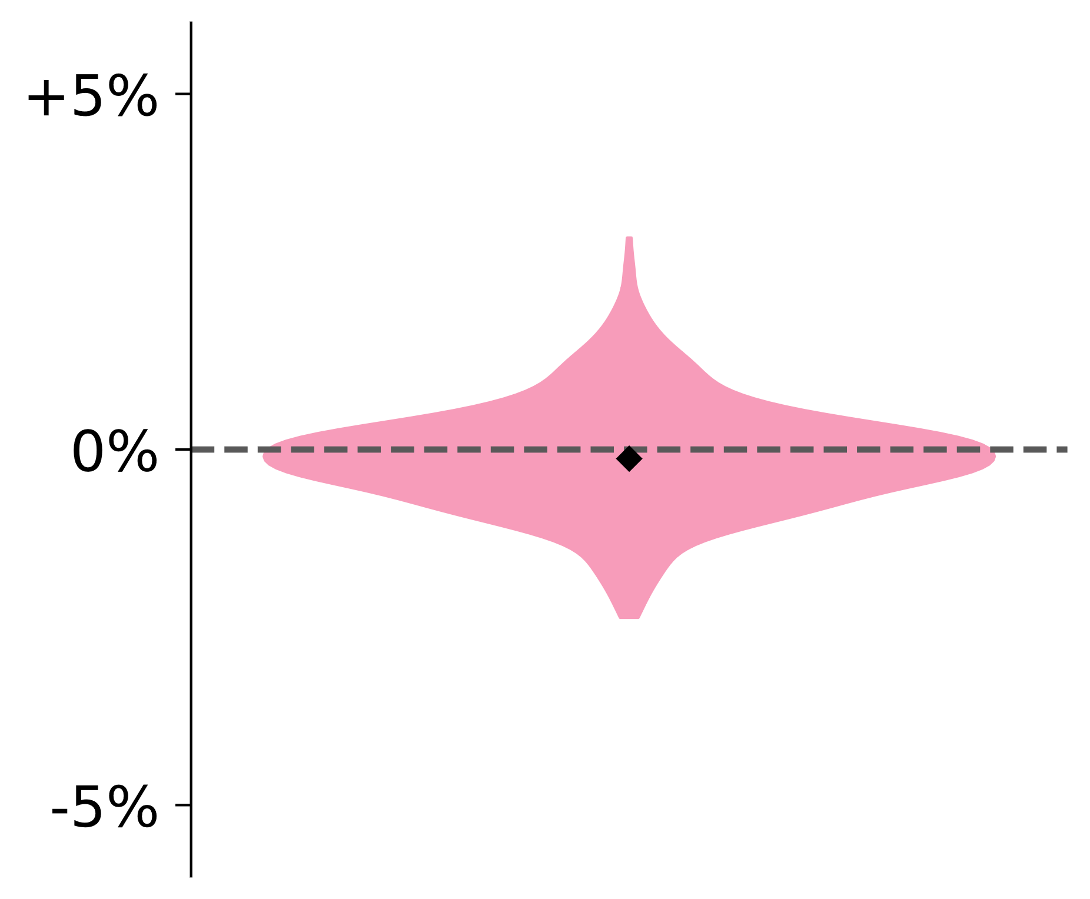
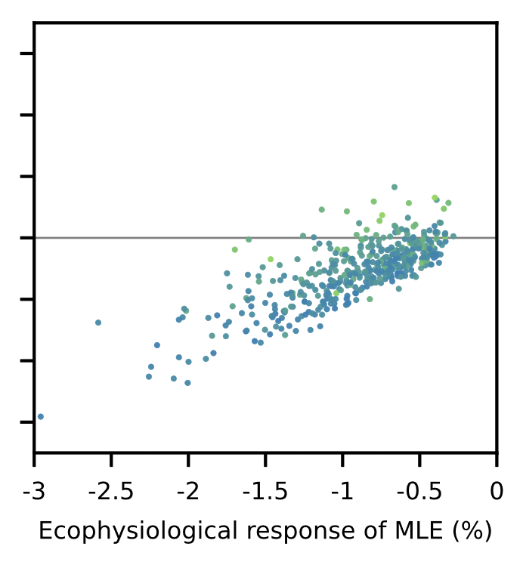
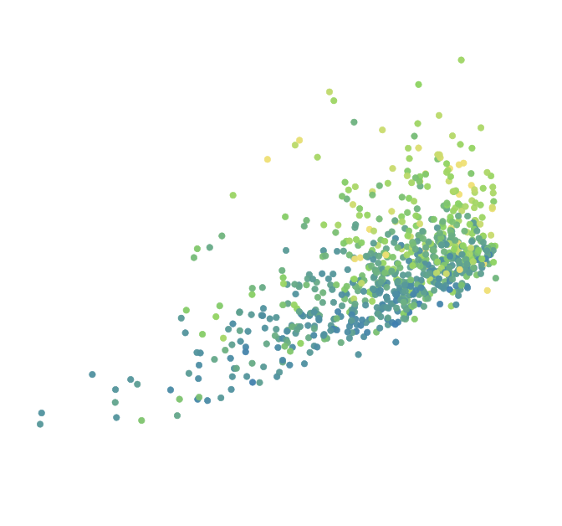
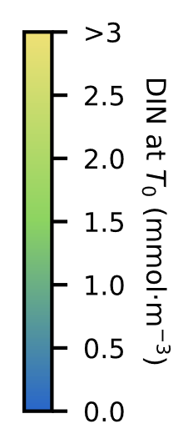
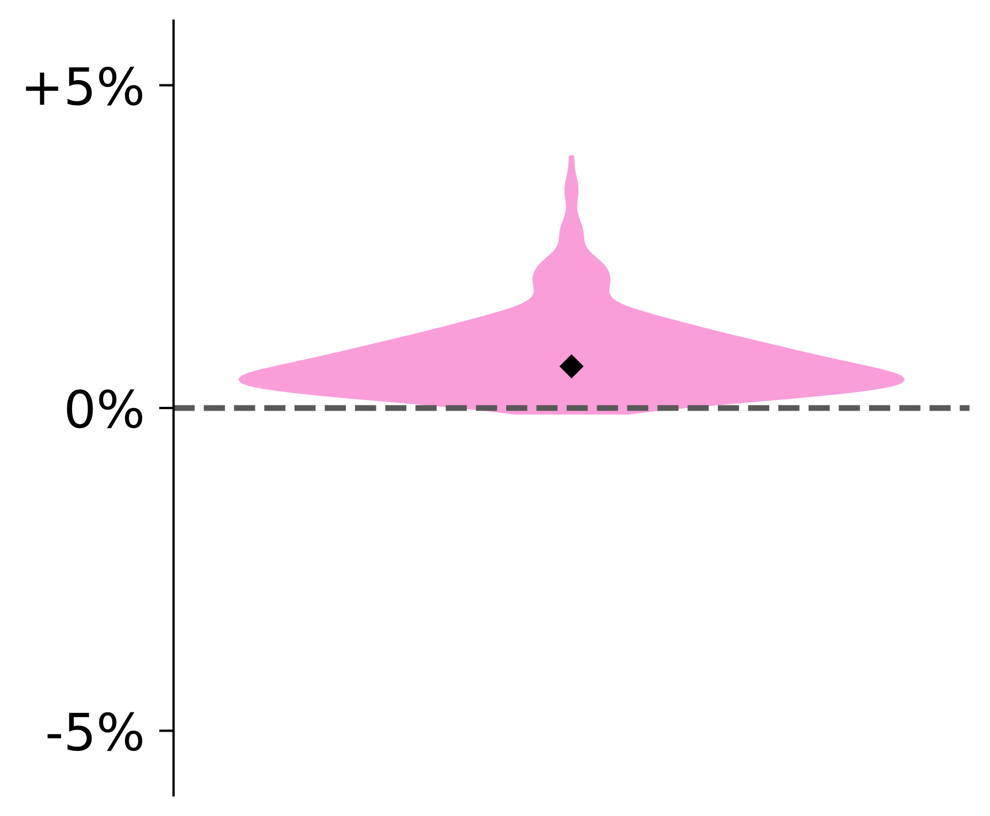
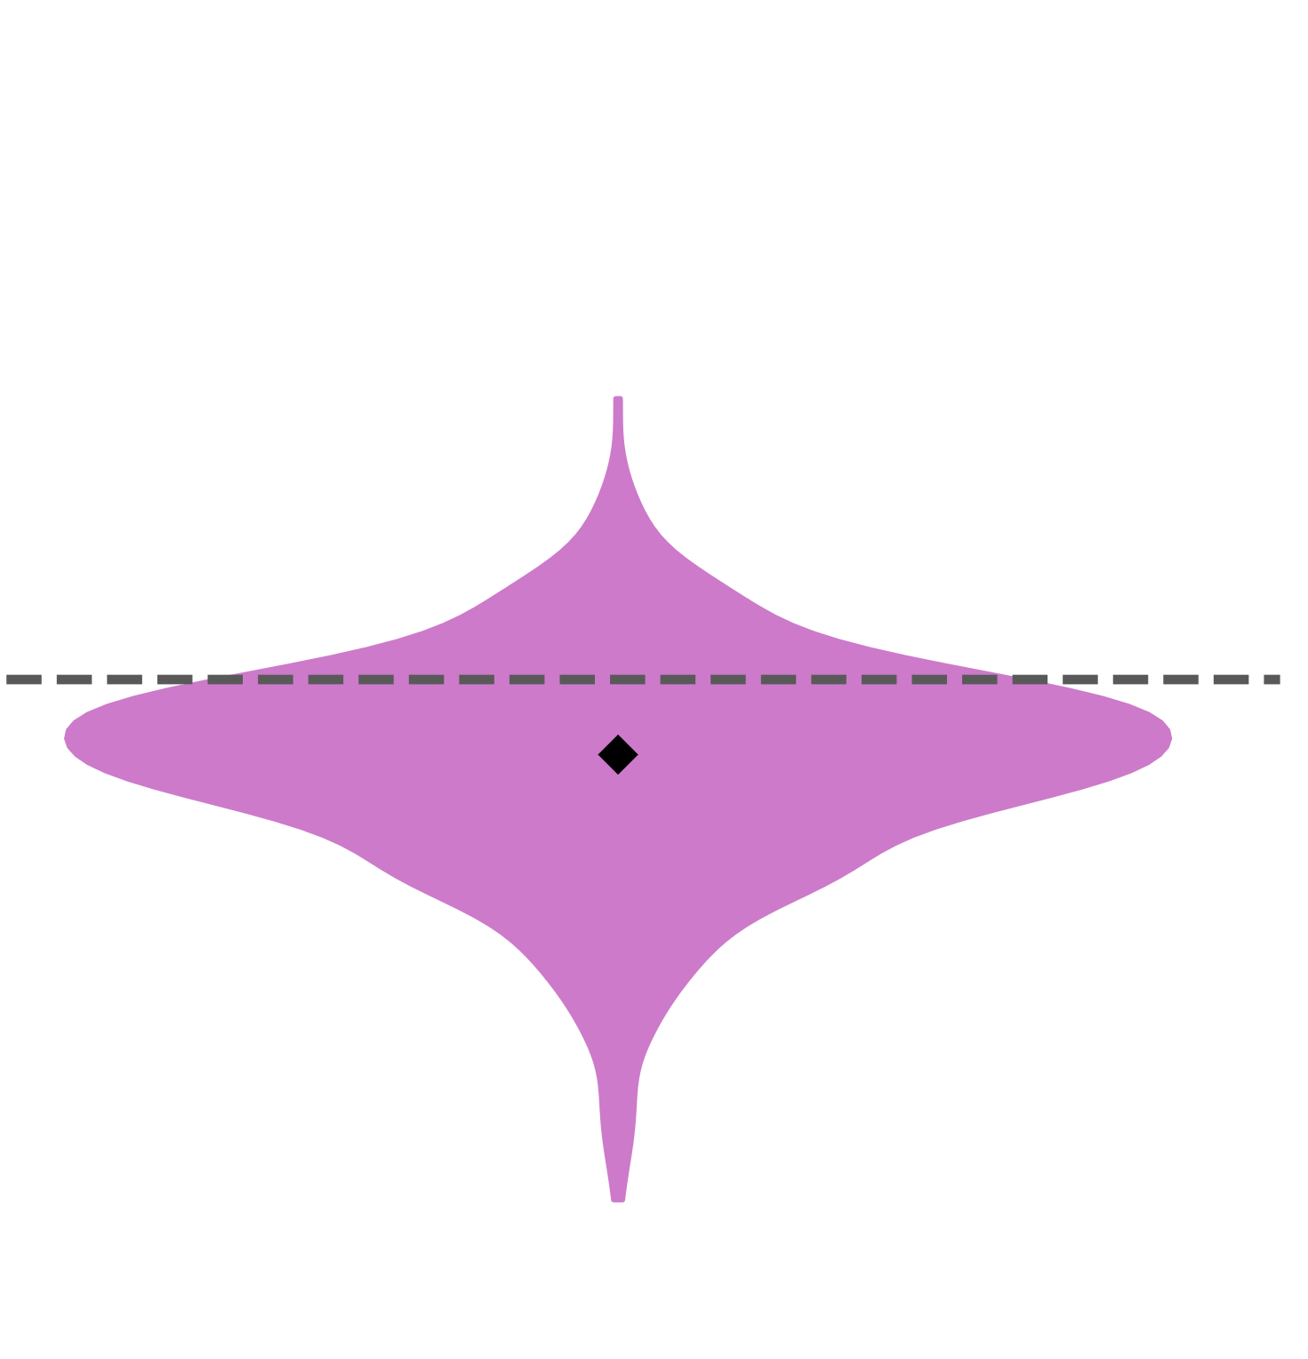
Variation to a 5°C increase
Total primary production
New
production
+
Regenerated
production
Variation to a 5°C increase
Despite the decrease in nitrogen concentration, primary production can either increase or decrease
The environmental variable most correlated to primary production variation is initial nutrient richness
Variations in microbial loop efficiency correlate to productivity variation, especially in oligotrophic regions
Primary production response to a 5°C increase
Notes:
We looked for the environmental variable best explaining the direction of PP variation
It was initial inorganic nitrogen nutrient concentration
This leads to focus on the divide between New and Regenerated production
And thus the importance of the microbial loop

Slide 30
Density law assumption
Phenotype discretization
Monomorphic population
Integrating natural selection in ESMs
Earth system models are not at an ecological equilibrium, so previous methods are irrelevant.
BGE
BGE
BGE
The ‘
generation
-selection
’ cycle
Individual-based model
Density-based model
0
1
BGE
Notes:
A paradigm shift: phenomenological description of natural selection

Slide 31
For each grid cell, the evolutionary dynamics are described by
The selection gradient equation
$$\frac{d\text{BGE}}{dt}=Σ(\text{BGE}\text{, }E)$$
Environmental state
The goal is to describe dynamical eco-evolutionary processes while keeping the basic structure of Earth system models intact.
$$=α⋅B⋅P(\text{BGE},E)$$
Adaptive capacity
Population size
NEMO-PISCES
Selection gradient
How can we define it in the context of Earth system models?
$$=$$
$$P\left(\text{BGE},E\right)$$
$$≈$$
$$dS(\text{BGE})$$
Phenomenological, not mechanistic!
S = instantaneous invasion fitness
A_{p}
Y_{p}
We keep the bacterial population monomorphic for each cell and describe adaptation through an ODE.
0
1
BGE
Notes:
Talk about the complexity and structure of NEMO-PISCES
It is a compartment model
Emphasize that each compartment is ‘monomorphic’
The chosen form for the ODE stems from the canonical equation of adaptive dynamics

Slide 32
Integration in NEMO-PISCES
Eco-evolutionary processes are integrated assuming LDOC limitation.
Global statistics
Notes:
Emphasize the LDOC limitations

Slide 33
Outline
Microbial loop
modelling
Sea-surface
ecosystem
Earth-system
models
Viral shunt
influence
Viral
transduction

Slide 34
Life cycle of a bacteriophage
Bacteria : Phage
Lytic phase
Lysogenic phase
Notes:
B:V ratio ~ 1:10
Contact
Infection
Replication
Lysis or 'burst'
Integration
Replication
Induction
We focus on the lytic phase, which induces the viral shunt

Slide 35
π
Bacteriophages in the microbial loop
Successful infection
Contact
We assume instant lysis and redirection of excess organic matter from the burst to the DOM pool (viral shunt).
Unsuccessful infection
1-π
Bacteria can invest in stress tolerance to decrease the value of π in a trade-off with bacterial growth efficiency.
Bacteria can develop strategies to defend themselves against bacteriophages.
BGE
1-π

Slide 36
A three-way trade-off
The ‘YAS’ framework
Respiration as a proxy
Three competing strategies in which to invest
BGE
1-BGE
Y
Total uptake
Growth
Supply
Individual uptake rate
Viral resistance
Respiration
Etc…
Maintenance
Uptake
Resistance
Uptake
Viral resistance
Supply
Maintenance
Etc…
A
S
Respiration
3 traits y, a, s with y + a + s = 1
Notes:
Mettre ‘rising tide lifts all boats »

Slide 37
ESS^{nb}
$$A_{p}^{NB}$$
$$Y_{p}^{NB}$$
Shifting the evolutionary stable strategy
0
BGE
1
We can still define the selection pressure as the sum of three distinct pressures: yield, resource acquisition and stress tolerance.
dS(BGE) = Y_{p} + A_{p} + S_{p}
?
dS(ESS^{nb})
Dealing with viral mortality
dS(ESS^{nb}) = $ΔA_{p}+ΔS_{p}$
€?
Dealing with increased DOM supply
Poor regions : BGE ↘
Rich regions: BGE ↗
Notes:
Dealing with viral mortality
Increase either defences (BGE ↘) or efficiency (BGE ↗) depending on relative costs.
Dealing with increased DOM supply
Phages induce a shift from a ‘bottom-up’ to a ‘top-down’ limited system. In nutrient-poor ecosystems, an increase in resource acquisition (BGE ↘) is more beneficial than an increase in efficiency (BGE ↗) and vice-versa.

Slide 38
Outline
Microbial loop
modelling
Sea-surface
ecosystem
Earth-system
models
Viral shunt
influence
Viral
transduction

Slide 39
The transduction process
Virion
Changed genotype
Gene transducing particle
Host
Infection
Lysis
Contact
Transfer
We aim to analyse how transduction impacts bacterial adaptation both analytically and numerically through an individual-centered, trait-based model.

Slide 40
Mutations
Modeling viral transduction
Virion
GTP
Population 1
We model non-homologous end joining transduction: gene transfer adds missing mutation without replacing host genome.
Invasion fixation cycle
+
=
Resident phenotype
Mutant GTP
Mutant phenotype
+
=
Mutant phenotype
Resident GTP
Mutant phenotype
With our modeling framework, gene transfer is unilateral from mutant to resident.
Population 2
Notes:
We consider an abstract trait
We first consider the invasion-fixation cycle to see adaptation speed

Slide 41
= maximum transduction probability
Transduction and adaptation speed
A mutant population has a fitness advantage independant of phenotype due to transduction. This can lead to the ‘bad gene effect’.
Time
Time
Time
Canonical equation
$$dX_{t}=μ(X_{t},t)+σ(X_{t},t)⋅dB_{t}$$
The stochastic part $σ\left(X_{t},t\right)$ is proportionnal to $\sqrt{p_{T}\left(X_{t},X_{t}\right)}$. Stochasticity directly results from the fitness advantage of transduction.
Transduction accelerates adaptation.
Notes:
Transduction adds stochasticity
It can favor deleterious traits, but the invasion fitness of advantageous traits is all the more improved

Slide 42
Low transduction
High transduction
Transduction and phenotypic diversity
We depart from the ‘invasion-fixation’ cycle and focus on genealogy to study phenotypic diversity.
Transduction event
ESS
ESS
0
>300
Population size

